Slide 1
AN OVERVIEW ON HEALTH CHECK PATTERNS

Slide 2



FAIL!

Slide 3


Slide 4

96%
99%
99%
CPU
RAM
99%
Network
99%
Disk

Slide 5

bugs
config issue
synchronization failed
memory leak
thread leak
pool misconfigurations
deadlocks

Slide 6
88.5%
CPU
RAM
CPU
RAM
CPU
RAM
Network
Network
Network
Disk
Disk
Disk
CLIENT
SERVER
DB

Slide 7
CPU
RAM
CPU
RAM
Network
Network
Disk
Disk
CLIENT
SERVER

Slide 8
CPU
RAM
Network
Disk
CPU
RAM
Network
CPU
RAM
Disk
Network
Disk
CPU
RAM
Network
CPU
RAM
Disk
Network
Disk

Slide 9

CPU
RAM
Network
Disk
CPU
RAM
Network
CPU
RAM
Disk
Network
Disk
CPU
RAM
Network
CPU
RAM
Disk
Network
Disk

Slide 10
HEALTH CHECK?

Slide 11
?
TELL? LIE?
CPU
RAM
!
Network
ACTION
Disk

Slide 12
!
ACTION
RESTART
TRAFFIC
SHAPING
DEPLOYMENTS
ALERTING
SCALING

Slide 13
TELL?
LIE?
N/A
SHALLOW
DEEP
PASSIVE

Slide 14
TELL?
LIE?
RETRIES
CIRCUIT
BREAKER
?
?
DEFAULTS
?
TIMEOUTS
FALLBACKS
Notes:
Retries?
- Not necessary, healtcheck can retry itself if you give it a lease period.
Fallbacks & Defaults?
- Deep healthcheck might ruin the effect of fallbacks
# Required patterns
Timeouts
- Either in application or at LB level

Slide 15
PATTERNS!

Slide 16
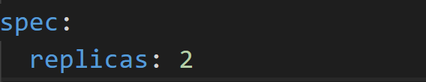
N/A
RESTARTS
Notes:
*Restart*
+ Based on existing requests / limits
*Traffic shaping*
N/A
*Alerting*
+ Based on the ratio of failed HTTP requests indirectly (passive)
+ Works for TCP as well!
- *DELAYING* if the rate drops because a dependent service timing out

Slide 17
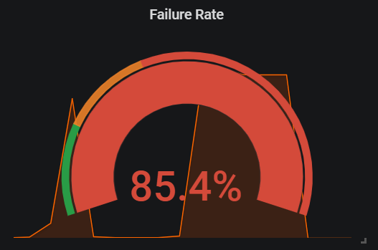
N/A
ALERTING
Notes:
*Restart*
+ Based on existing requests / limits
*Traffic shaping*
N/A
*Alerting*
+ Based on the ratio of failed HTTP requests indirectly (passive)
+ Works for TCP as well!
- *DELAYING* if the rate drops because a dependent service timing out

Slide 18
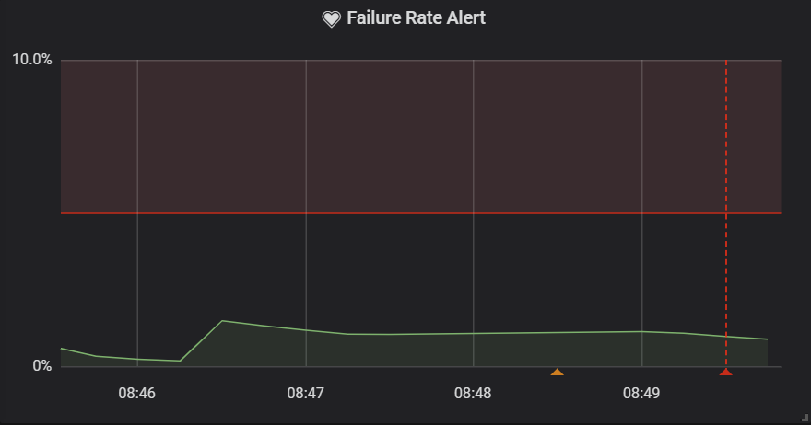
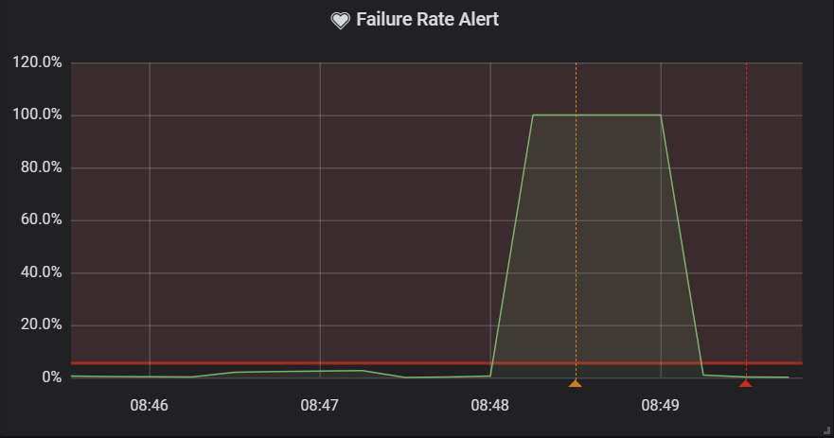
N/A
ALERTING
Interval = 5m
Interval = 1m
Notes:
*Restart*
+ Based on existing requests / limits
*Traffic shaping*
N/A
*Alerting*
+ Based on the ratio of failed HTTP requests indirectly (passive)
+ Works for TCP as well!
- *DELAYING* if the rate drops because a dependent service timing out

Slide 19
N/A
TRAFFIC SHAPING
DEPLOYMENTS
Notes:
*Restart*
+ Based on existing requests / limits
*Traffic shaping*
N/A
*Alerting*
+ Based on the ratio of failed HTTP requests indirectly (passive)
+ Works for TCP as well!
- *DELAYING* if the rate drops because a dependent service timing out

Slide 20
N/A
memory leak
thread leak
bugs
config issue
pool misconfigurations
deadlocks
Notes:
*Restart*
+ Based on existing requests / limits
*Traffic shaping*
N/A
*Alerting*
+ Based on the ratio of failed HTTP requests indirectly (passive)
+ Works for TCP as well!
- *DELAYING* if the rate drops because a dependent service timing out

Slide 21
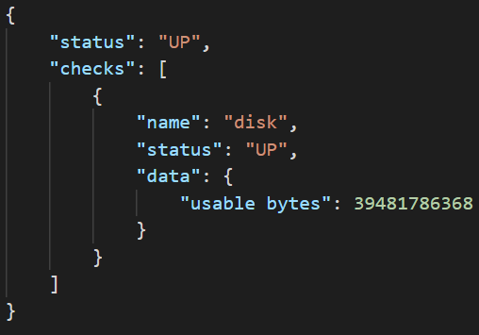
SHALLOW
Notes:
## Shallow healthcheck
*Restarts*
+ Helps if application has: memory, thread leak
- Won't help if dependent service becomes unavailable
- Won't help in case of deadlocks, pool misconfigs, bugs
*Traffic shaping*
+ Guarantees that only healthy services will recieve traffic
+ Reduces failure rate becasue of downtime
- Won't help if dependent services are not operational
*Alerting*
+ Based on reported health check status
- Not working if a dependent service is not operational
+ Based on the ratio of failed HTTP requests indirectly (passive)
- *DELAYING* if the rate drops because a dependent service timing out

Slide 22
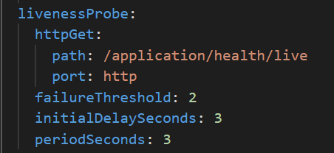
RESTARTS
SHALLOW
Notes:
## Shallow healthcheck
*Restarts*
+ Helps if application has: memory, thread leak
- Won't help if dependent service becomes unavailable
- Won't help in case of deadlocks, pool misconfigs, bugs
*Traffic shaping*
+ Guarantees that only healthy services will recieve traffic
+ Reduces failure rate becasue of downtime
- Won't help if dependent services are not operational
*Alerting*
+ Based on reported health check status
- Not working if a dependent service is not operational
+ Based on the ratio of failed HTTP requests indirectly (passive)
- *DELAYING* if the rate drops because a dependent service timing out

Slide 23
DEEP

Slide 24
PASSIVE

Slide 25
DEMO!

Slide 26







Envoy
CPU
RAM
Network
Disk

Slide 27


Slide 28

AN OVERVIEW ON HEALTH CHECK PATTERNS

